Slide 1

Problem
Can machine learning predict EPL 2022-23 results using historical data, team metrics, and relevant factors?
How can we evaluate the accuracy and effectiveness of our machine learning model for predicting EPL results, and what metrics should we use to measure its performance?
How can we ensure that our machine learning model is robust and reliable, even in the face of unexpected events or changes that may occur during the 2022-2023 EPL season?
1

Slide 2

Total results prediction of EPL in season 2022-2023
Group 4 – ICT
Dr.Doan Nhat Quang
2

Slide 3

Members
BI11-110 Phung Gia Huy
BI11-195 Nguyen Hoai Nam
BI11-198 Hoang Duc Nghia
BI11-236 Bui Hong Son
BI11-273 Nguyen Dang Trung
BI11-286 Nguyen Xuan Vinh
3

Slide 4
Contents
Introduction
Motivation
Project Implementation
Result and Discussion
Future Work
References
4

Slide 5

Introduction
- English Premier League (EPL)
+ The most popular football leagues in the world
+ Attracting million of fans and bettors every season
This project use historical EPL data
(seasons 2020-2021 & 2021-2022)
+ Analyze historical EPL data and train model
+ Machine learning algorithms => predictive model => predict result
5

Slide 6
Motivation
Providing valuable insights
01
Enhancing the fan experience
02
Improving betting strategies
03
Advancing machine learning techniques
04
6

Slide 7
Project implementation
Collecting Dataset Preprocessing Data Feature Selection Model Selection | Model Evaluation Data Visualization Experiments Prediction
7

Slide 8

Collecting Data
- Collect statistics on all matches, all clubs, all players in two seasons 2020-2021 & 2021-2022.
- Then, we divide all data we collect into three .csv files
+ Statistics about all clubs
+ Statistics about all players
+ Statistics about all matches
8

Slide 9
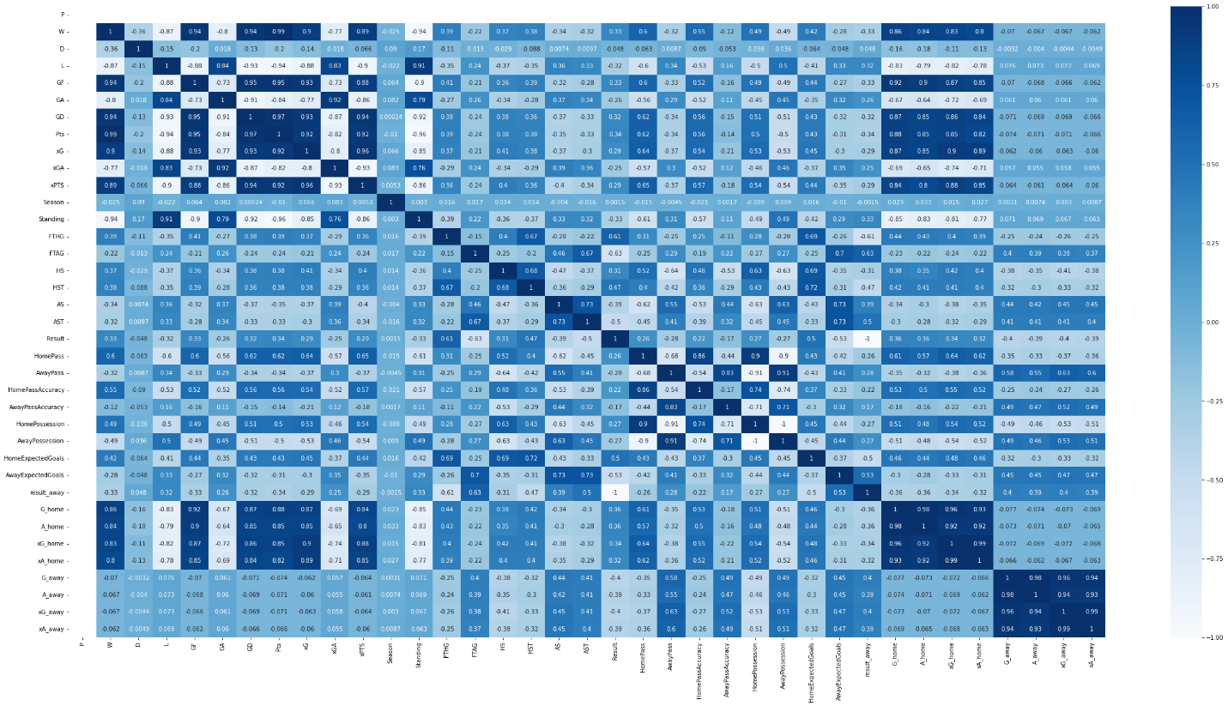

Preprocessing Data
Check the data carefully and try to merge all datasets into one dataset to transform the data to suitable format for analysis.
Check missing values if any data is empty
38 features corresponding to 38 columns in the overall dataset
Choose positive correlation depends on meaning both variables move in the same direction
9

Slide 10

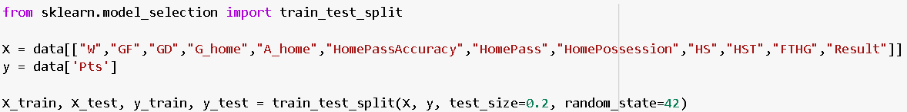
Feature Selection
Identify most relevant and informative features or variables in dataset that be used to make accurate predictions or classifications
From correlation matrices, we have our choice that there are features that we have selected:
10

Slide 11
Model Selection
Linear regression:
+ Simplicity
+ Interpretable
+ Fast
+ Versatile
+ No assumptions about distribution
+ Baseline model
Random Forest Regressor:
+ High accuracy
+ Robustness
+ Versatility
+ Feature importance
+ Robust to outliers
+ Scalability
11

Slide 12
Model Evaluation
Evaluate the performance of the trained model using appropriate metrics:
Helps to ensure the model is not overfitting & generalize well to new data
Random Forest Regressor
+ Calculate the Mean squared error and R Square to evaluate
+ the Mean squared error ~ 0.006 => Small value
+ R Square is roughly 0.99997 ( near 1 )
=> This model has quite low error and high accuracy
Linear regression
+ Also compute the Mean squared error and R Square to evaluate
+ Mean squared error is approximately 4.56 ( quite big )
+ R Square is roughly 0.98 (smaller than Random Forest Regressor )
=> This model has quite high error & the accuracy may be not quite high
12

Slide 13

Data Visualization
- 3 Types to visualize:
+ Random Forest Regressor
+ Radar Chart
+ Bar Chart
13

Slide 14
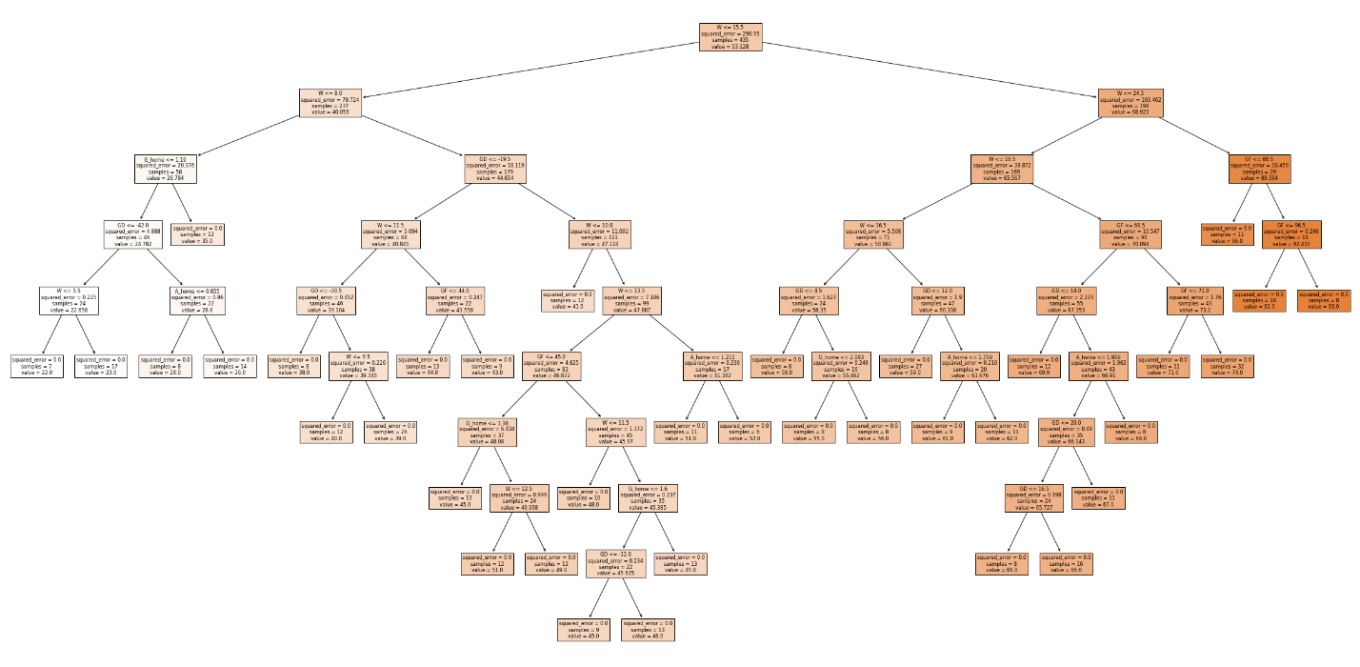
Random Forest Regressor
14

Slide 15
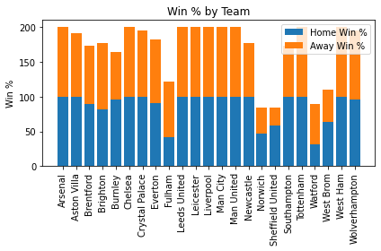
15

Slide 16
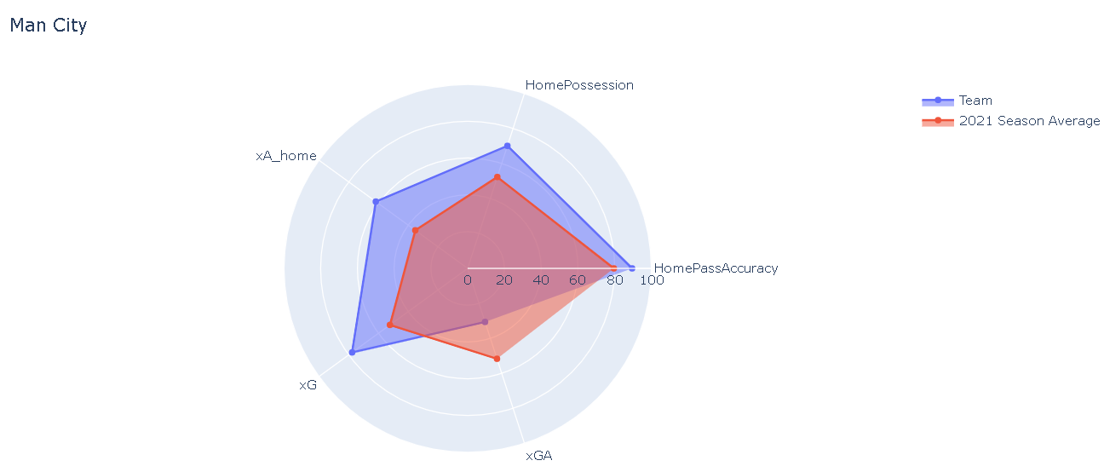
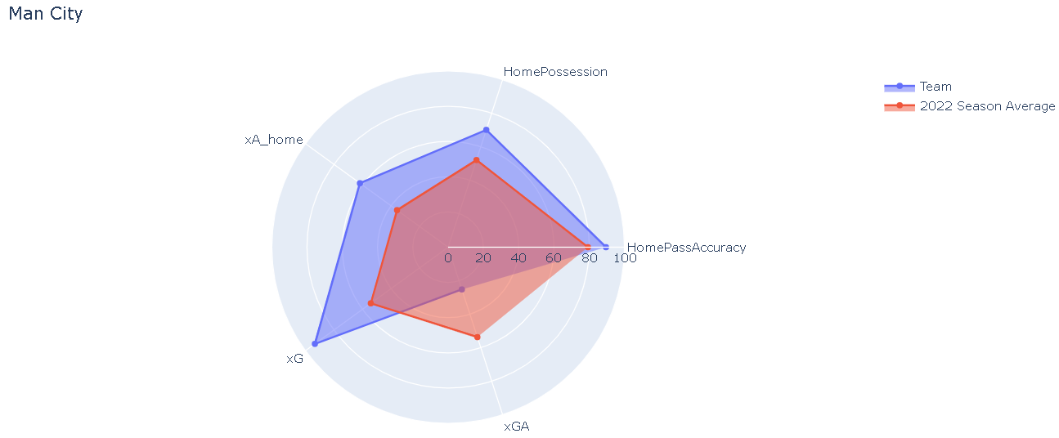
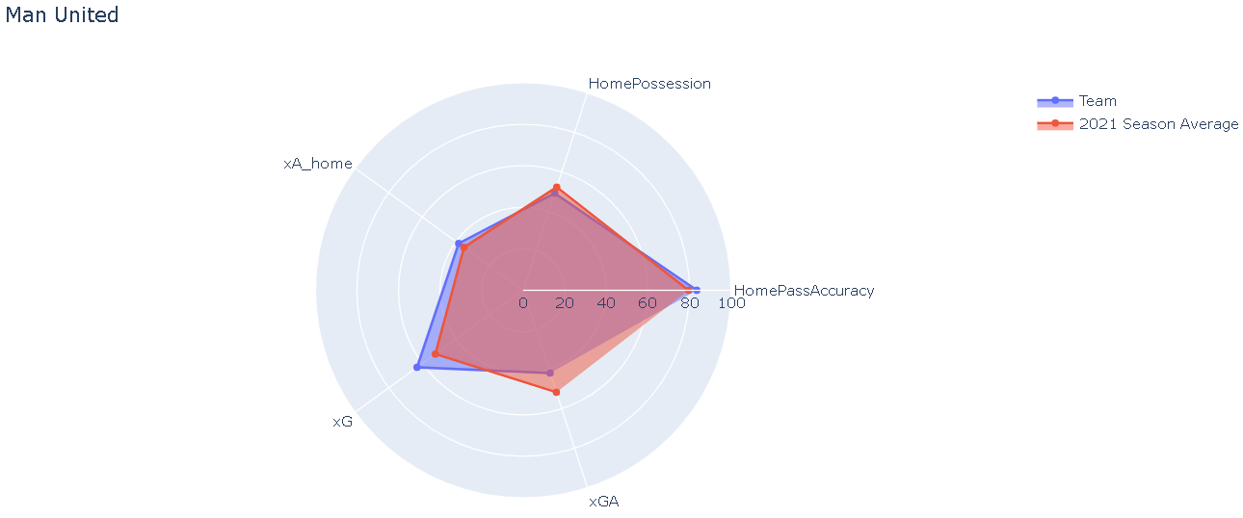
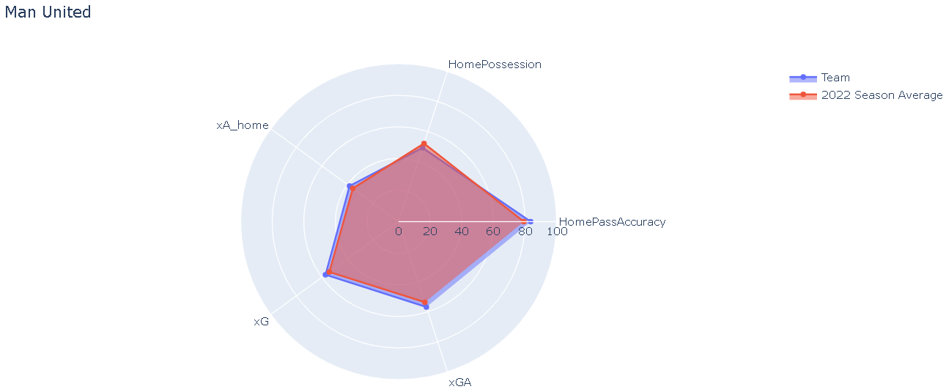
Radar Chart
16

Slide 17
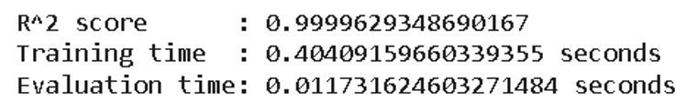
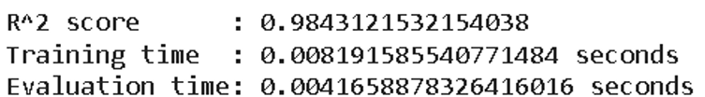
Experiments
Random Forest Regressor
Calculate the complexity or running time of model
Linear Regression
17

Slide 18
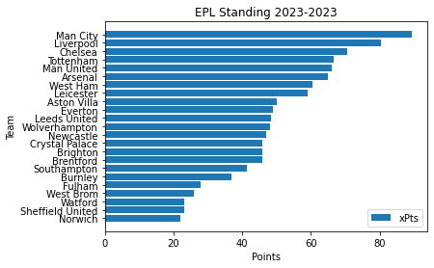
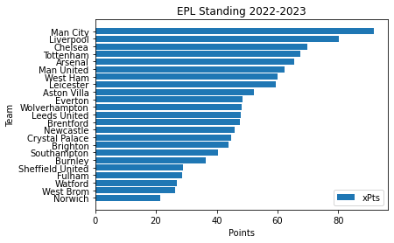
Prediction
Random Forest Regressor
Linear regression
18

Slide 19
Result and Discussion
19

Slide 20

Results
Present the results of our experiment
Predict the club first place: Manchester City
Top 6 EPL includes the following teams: Manchester City, Liverpool, Chelsea, Tottenham, Manchester United, Arsenal.
20

Slide 21

Discussion
Was difficult to get the right direction for the project
Data collection problem
Model Selection
Feature Selection
Not simple to handle Model Performance
Interpretation’s problem
Section “Prediction” problem
=> Challenging but also rewarding
21

Slide 22

Future work
Model Improvement
Data Collection and Integration
Real-Time Predictions
Visualizations and Dashboards
Multi-Season Analysis
Model Deployment
22

Slide 23

If our ML model is accurate & effective
=> significant impact on strategic decision-making of coaches, managers:
+ Tactical planning
+ Transfer strategies
+ Squad selection
+ Fan engagement
23

Slide 24
References
PYTHON CHARTS. Retrieved 10/3/2023, from
https://python-charts.com/ranking/radar-chart-plotly/?fbclid=IwAR2hwAfEdeCjuLCJX707nHZ0Rdo2O9Q8YWkq_3-L29GbltZ-LXdr2R-Wklk
2. Understat. Retrieved 10/3/2023, from
https://understat.com/league/EPL?fbclid=IwAR1AEgrV9UD-3QPz3ANAuiiGcgKcPyRZVrLPfOTminDMTRr8Y6TTPvuiyjM
3. WhoScored.com. Retrieved 11/03/2023, from
https://1xbet.whoscored.com/Regions/252/Tournaments/2/Seasons/9075/Stages/20934/Show/England-Premier-League-2022-2023?fbclid=IwAR3wvb6ALshciV3AKjKqhUoQ0AjUEsc-Sjh7iDbl2VhsKP05nFdDyjTPUtc
4. IBM. Retrieved 12/03/2023, from
https://www.ibm.com/topics/random-forest?fbclid=IwAR2mISC2wvZJJvaFZ2czOu20d9cQxVDd2XIi-MXj4TkZTC-7WcdTEwvtQKk#:~:text=Random%20forest%20is%20a%20commonly,both%20classification%20and%20regression%20problems
5. Java T point. Retrieved 12/03/2023, from
https://www.javatpoint.com/multiple-linear-regression-in-machine-learning?fbclid=IwAR1jDOSnH-_2XzYWa7rL4KAKsB-kXVqUoe0kbnIQIhvQQg_Ss5VrYnac6xI
24

Slide 25

25

